Slide 1


MGM’s College of Engineering & Technology
Department of Computer Engineering
Academic Year: 2019-20
ONLINE CAREER PLANNER
Presented by :
Saurabh Khade (116CP1235A)
Rakshit Koli (116CP1303A)
Soham Kubal (116CP1043A)

Slide 2

Content
Introduction
Future Scope
Problem Statement
Objective
Technology Stack
System Working
Features
Conclusion

Slide 3
To help Students choose the best career path using our proposed system Online Career Planner.
The proposed system will evaluate students aspects to help them decide on a career path.
This aspect are personal interests, skills, aptitude, comfort, etc.
This system will remove problem of lack of fast and reliable access to useful information needed to make career choice.
WHY WE NEED THIS PROJECT?

Slide 4

Problem Statement
To design an online career planner that lends a helping hand to the students aiming
for suitable stream after 12th.
To provide comprehensive quizes to test the student for various career paths.
The proposed system must help students select a proper career path depending upon the present skill sets and mental
abilities.

Slide 5
Technology Stack
Web/client:
HTML,
JS
CSS
Backend:
PHP
Data:
MySQL

Slide 6
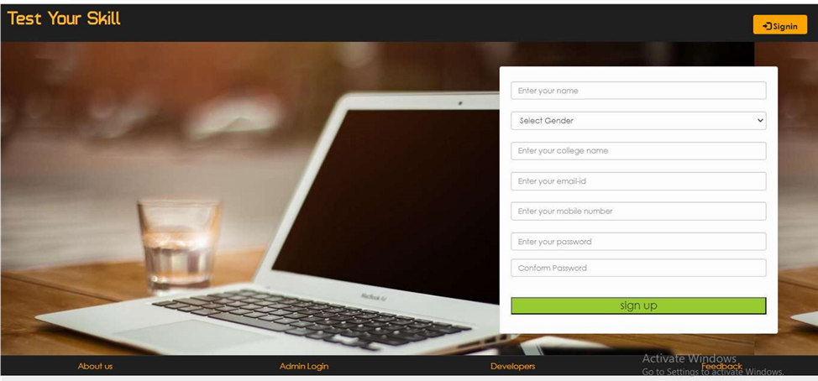
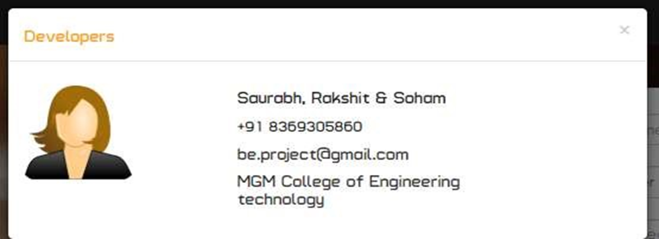
System Working
Home Page
Developers window

Slide 7
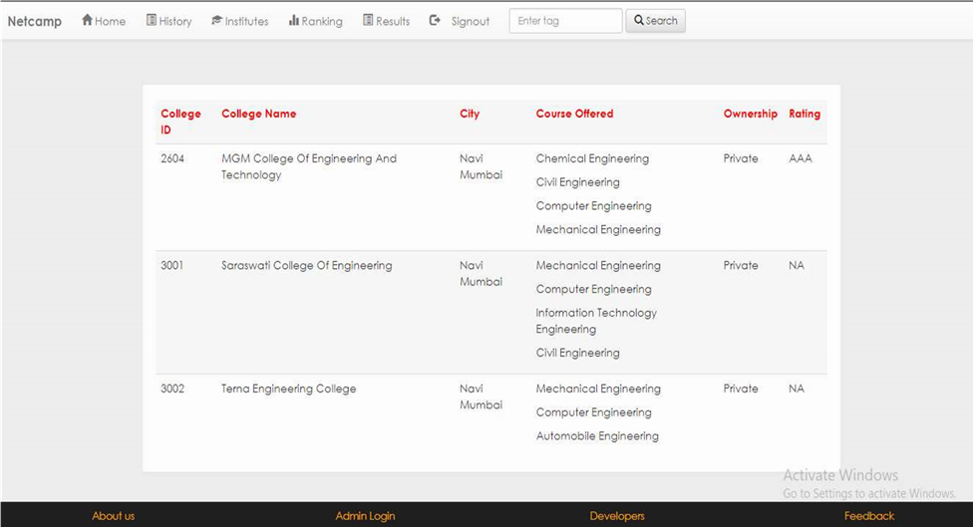
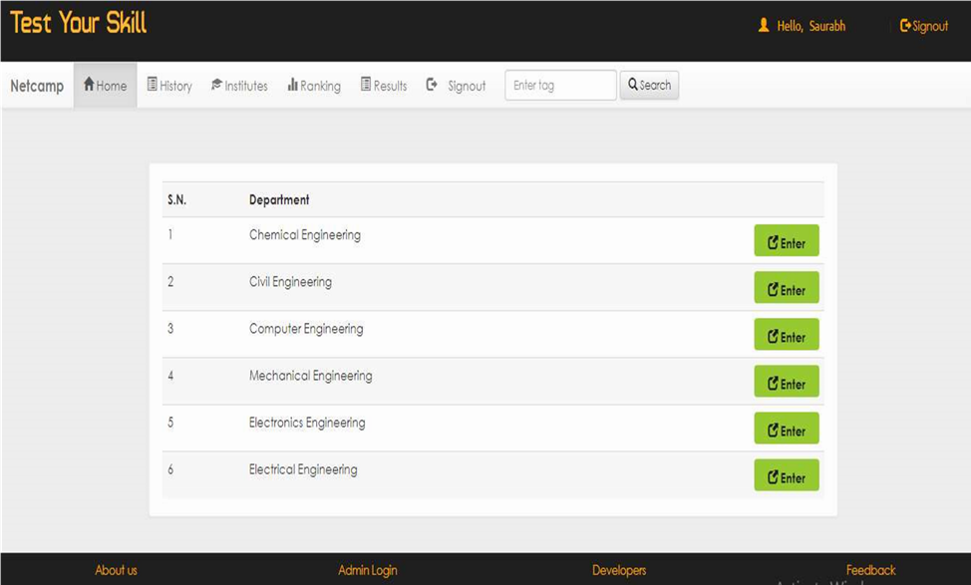
Institute details
Test according to branch

Slide 8
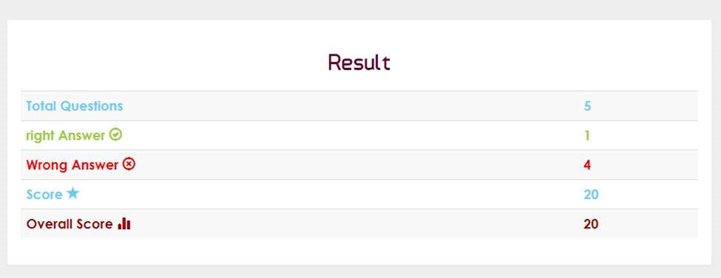
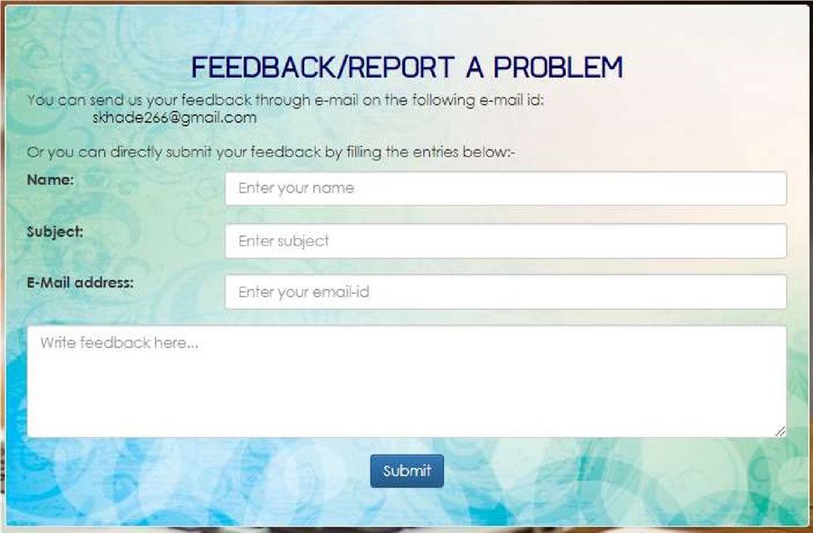
Result
Feedback Form

Slide 9
Features
WIDE ARRAY OF QUIZZES FOR EVERY FIELD
HELPS TO SET GOALS
Goal
FOCUS & IDENTIFY YOUR SKILLS
MEASURABLE SCORE AND RANK

Slide 10


Conclusion
The objective of our proposed system is : To lend a helping hand for students aiming for career in engineering.
To assist students to select a Proper path/department depending on their personal skill set & mental abilities.
Our system at this point is entirely based on academic subjects & not on vocational subjects that depend on individual liking.

Slide 11
Future Scope
To add large no. of respective questions and create a Questionnaire module which will select a certain no. of questions and jumble them up.
To include other fields as well.(B.A, B.com, Pharma , etc.)
To expand & improvise this system to include vocational subjects as well.

Slide 12
Thank you！

